Slide 1



UNIVERSITY INSTITUTE OF ENGINEERING
COMPUTER SCIENCE ENGINEERING
Bachelor of Engineering
Theory of Computation (CST-353)
Topic: Kleen’s Theorem
DISCOVER . LEARN . EMPOWER

Slide 2
Learning Objectives & Outcomes
Objective:
To understand the concept of Kleene’s Theorem.
Outcome:
Student will understand the
  Kleene’s Theorem

Slide 3
Kleene’s Theorem
Theorem 1 (Part 1 of Kleene's theorem): Any regular language is accepted by a finite automaton.
Proof: This is going to be proven by (general) induction following the recursive definition of regular language.
Notes:
Cpt S 317: Spring 2009
School of EECS, WSU

Slide 4
Inductive Step
Inductive Step: We are going to show that for any languages L₁ and L₂ if they are accepted by FAs, then L₁∪ L₂ , L₁L₂ and L₁* are accepted by FAs. Since any regular language is obtained from { ʌ } and { a } for any symbol a in Σ by using union, concatenation and Kleene star operations, that together with the Basis Step would prove the theorem.

Slide 5
Inductive Step (Continue..)
Suppose that L₁ and L₂ are accepted by FAs M₁ = < Q₁ , Σ , q_{1,0} , δ ₁ , A₁ > and M₂ = < Q₂ , Σ , q_{2,0} , δ ₂ , A₂ > , respectively. We assume that Q₁ Q₂ = Ø without loss of generality since states can be renamed if necessary.
Then L₁∪ L₂ , L₁L₂ and L₁* are accepted by the FAs M_{u} = < Q_{u} , Σ , q_{u,0} , δ _{u} , A_{u} > , M_{c} = < Q_{c} , Σ , q_{c,0} , δ _{c} , A_{c} > and M_{k} = < Q₂ , Σ , q_{k,0} , δ _{k} , A_{k} > , respectively, which are given below.
M_{u} = < Q_{u} , Σ , q_{u,0} , δ _{u} , A_{u} > :
Q_{u} = Q₁ ∪ Q₂ ∪ { q_{u,0} } , where q_{u,0} is a state which is neither in Q₁ nor in Q₂ .
δ _{u} = δ ₁ ∪ δ ₂ ∪ { (q_{u,0}, ʌ , { q_{1,0} , q_{2,0} } ) } , that is δ _{u}(q_{u,0}, ʌ ) = { q_{1,0} , q_{2,0} } . Note that δ _{u}(q_{u,0}, a ) = Ø for all a in Σ .
A_{u} = A₁ ∪ A₂

Slide 6
Inductive Step (Continue..)
M_{c} = < Q_{c} , Σ , q_{c,0} , δ _{c} , A_{c} > :
Q_{c} = Q₁ ∪ Q₂
q_{c,0} = q_{1,0}
δ _{c} = δ ₁ ∪ δ ₂ ∪ { (q, ʌ , { q_{2,0} } ) | q ∈ A₁ }
A_{c} = A₂

Slide 7
Inductive Step (Continue..)
M_{k} = < Q_{k} , Σ , q_{k,0} , δ _{k} , A_{k} > :
Q_{k} = Q₁ ∪ { q_{k,0} } , where q_{k,0} is a state which is not in Q₁ .
δ _{k} = δ ₁ ∪ { (q_{k,0}, ʌ , { q_{1,0} } ) } ∪ { (q, ʌ , { q_{k,0} } ) | q ∈ A₁ }
A_{k} = { q_{k,0} }
These NFA- ʌ s are illustrated below.

Slide 8
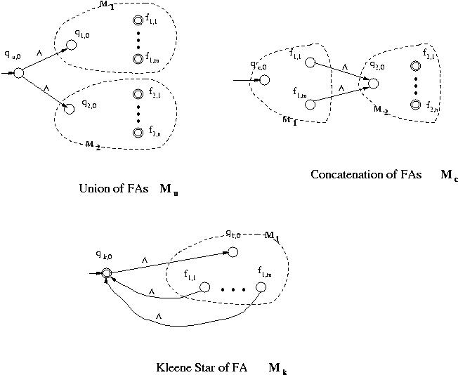
It can be proven, though we omit proofs, that these NFA- ʌ s , M_{u}, M_{c} and M_{k} , in fact accept L₁∪ L₂ , L₁L₂ and L₁*, respectively.
End of Proof

Slide 9
Kleene’s Theorem Part-2
Kleene’s Theorem Part-2
In this section we prove that if L is accepted by a finite automaton, then L is regular. The proof will provide an algorithm for starting with an FA that accepts L and finding a regular expression that describes L.

Slide 10
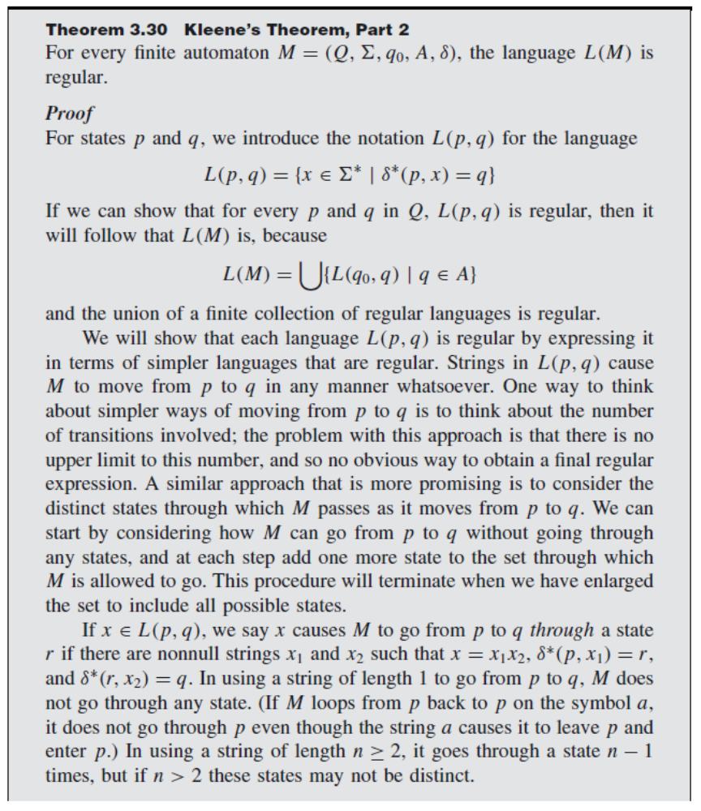

Slide 11
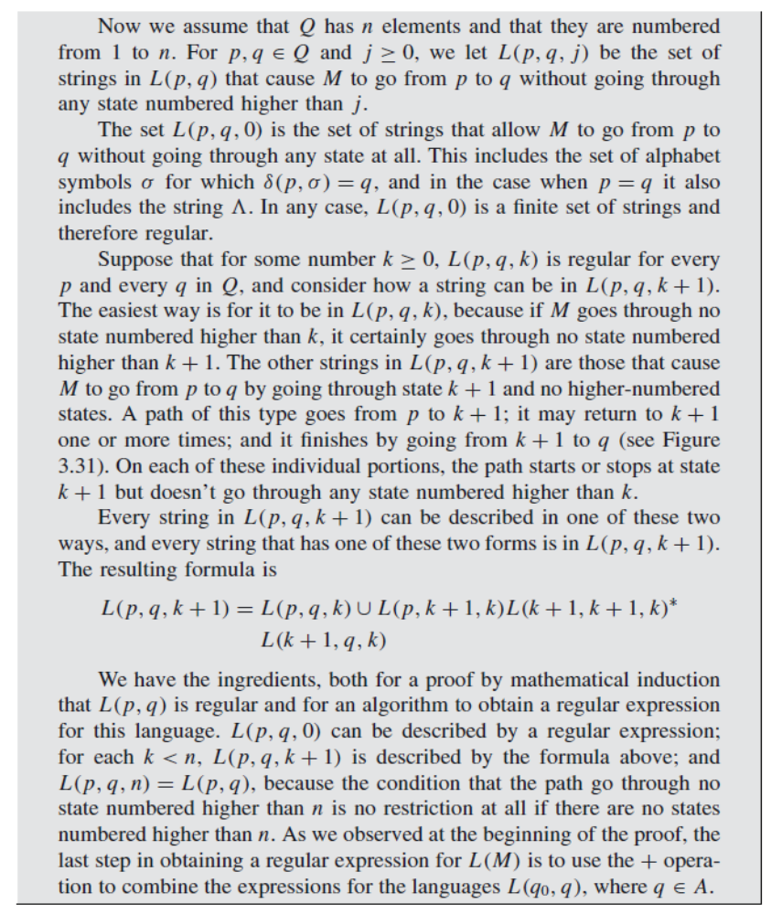

Slide 12
Summary
Kleene’s Theorem
  Part 1
  Part 2

Slide 13
References
Martin J.C., “Introduction to Languages and Theory of Computation”, Tata McGraw-Hill Publishing Company Limited, 3rd Edition
https://www.geeksforgeeks.org/kleenes-theorem-in-toc-part-1/
https://www.cs.odu.edu/~toida/nerzic/390teched/regular/fa/kleene-1.html#:~:text=It%20states%20that%20any%20regular,by%20an%20FA%20is%20regular

Slide 14
THANK YOU

